Slide 1
Progress Reporting (Week 3)
Design and implement the model of smart garden
Group 1 - Increment 1

Slide 2
Increment 1 – Goals & Deliverable
Goals
Understanding interfaces and protocol in system.
Identify sensors, will be used in system.
Given clearly model for overview of system.
Order fixed hardware.
Given a basic design in backend and framework.
Deliverable
Software Project Management Plan
Software Requirement Specification

Slide 3
Increment 1 – To do list
Research:
Temperature and humidity sensors
I²C: connect sensors with CC1310 in Sub Controller
UART: communication in Main Controller (CC1310 with Raspberry)
RF: connection between Main Controller with Sub Controller
Load indexes of sensors to MCU
Tools and technique to build web server
Android Application UI
Design
System Database
Webserver

Slide 4
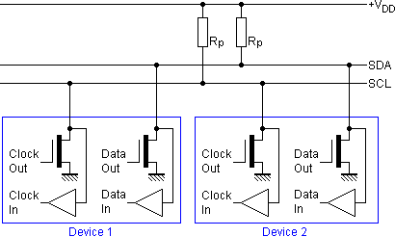
Increment 1 – Completed
Research I²C protocol (Nghihh)
Structure and Principles

Slide 5
Increment 1 – Completed
Research I²C protocol (Nghihh & Chinhph)
Activity Mode
Based on Speed:
+ Standard Mode
+ Low-Speed Mode
Based on Master – Slave Relative
+ One Master – One Slave
+ One Master – Many Slave
+ Many Master – Many Slave

Slide 6
Increment 1 – Completed
Research I²C protocol (Nghihh & Chinhph)
Activity Mode
Based on Speed:
+ Standard Mode
+ Low-Speed Mode
Based on Master – Slave Relative
+ One Master – One Slave
+ One Master – Many Slave
+ Many Master – Many Slave

Slide 7
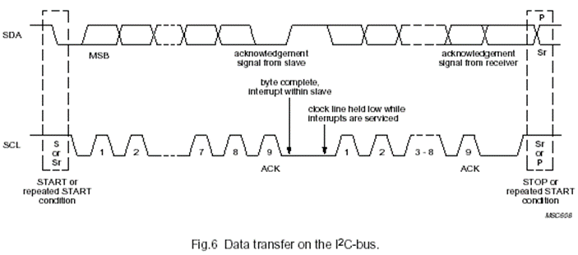
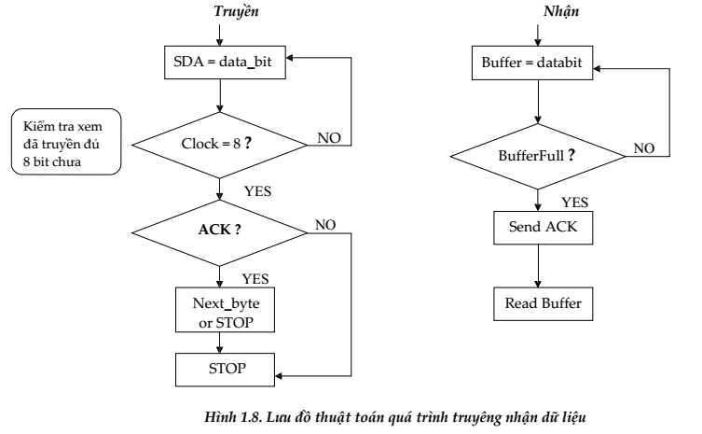
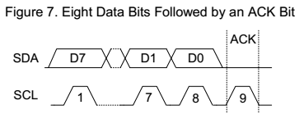
Increment 1 – Completed
Research I²C protocol (Nghihh & Chinhph)
Addressed and Data Transfer

Slide 8
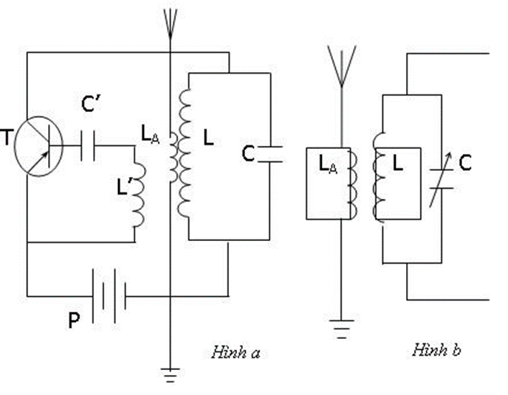
Increment 1 – Completed
Research RF connection

Slide 9
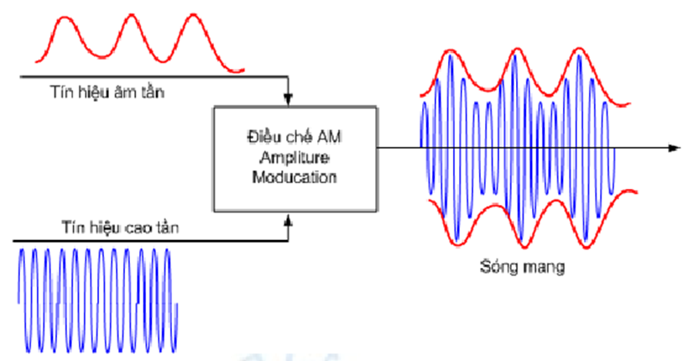
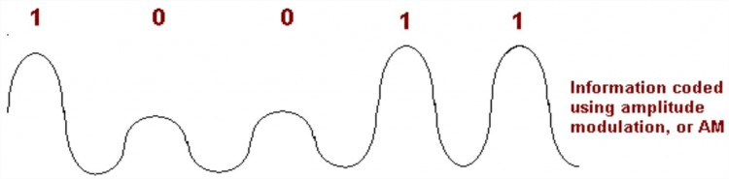
Increment 1 – Completed
Research RF connection
AM

Slide 10
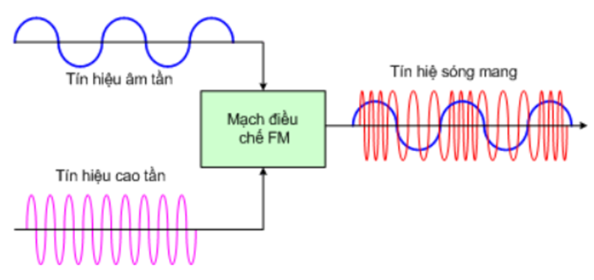
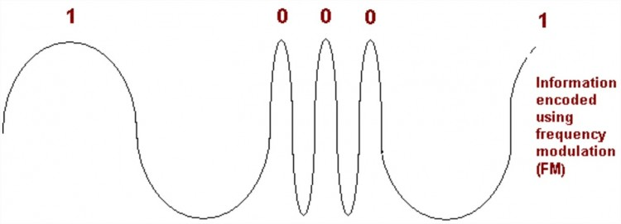
Increment 1 – Completed
Research RF connection (Chinhph)
FM

Slide 11


Increment 1 – Completed
Tools & Technique to build Web server (Phaplv)

Slide 12
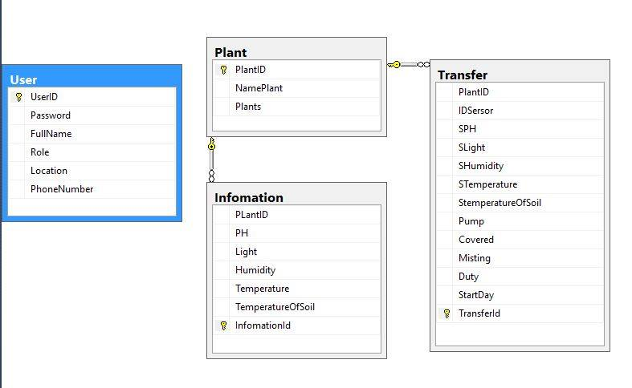
Increment 1 – Completed
Design Database (Sangpt, Phaplv)

Slide 13
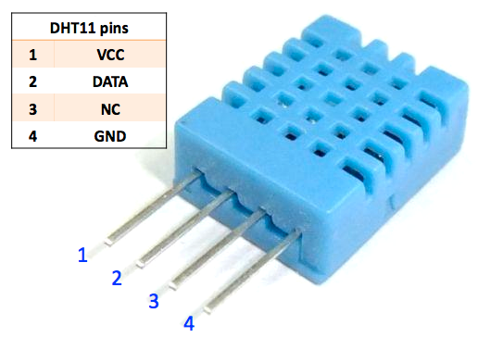
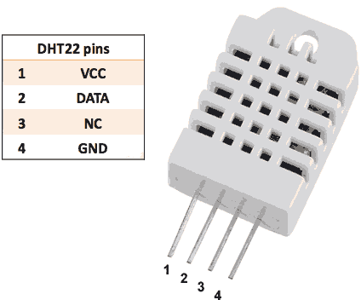
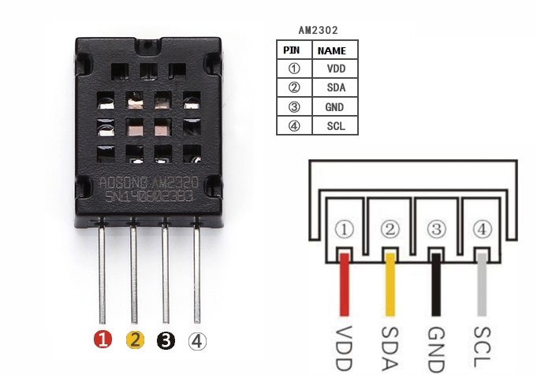
Increment 1 – In progress
Temperature and humidity sensors (Sangpt)

Slide 14
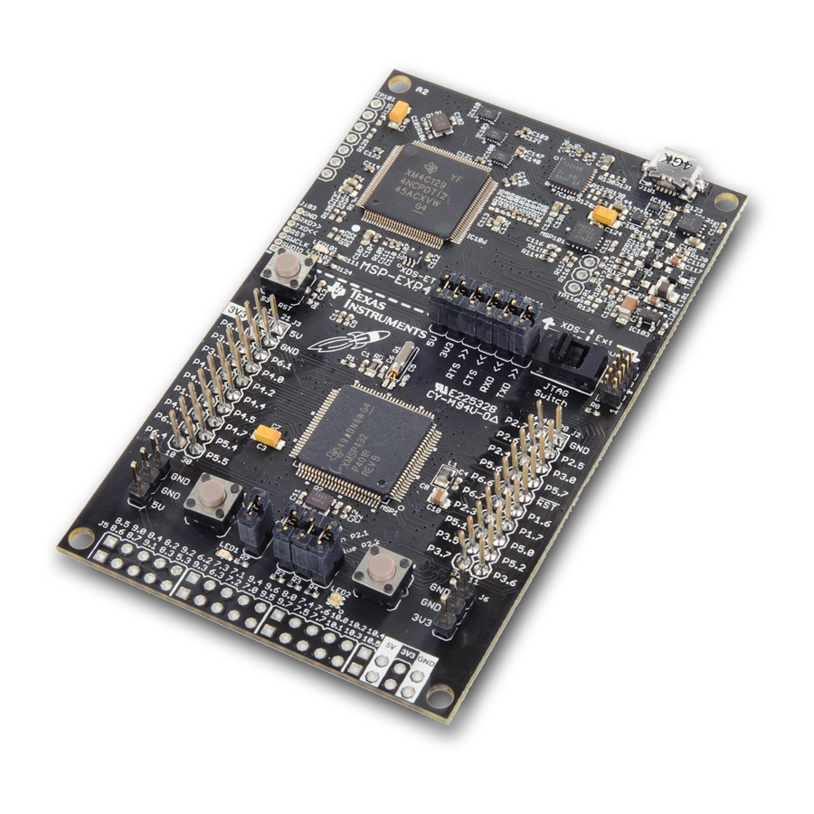
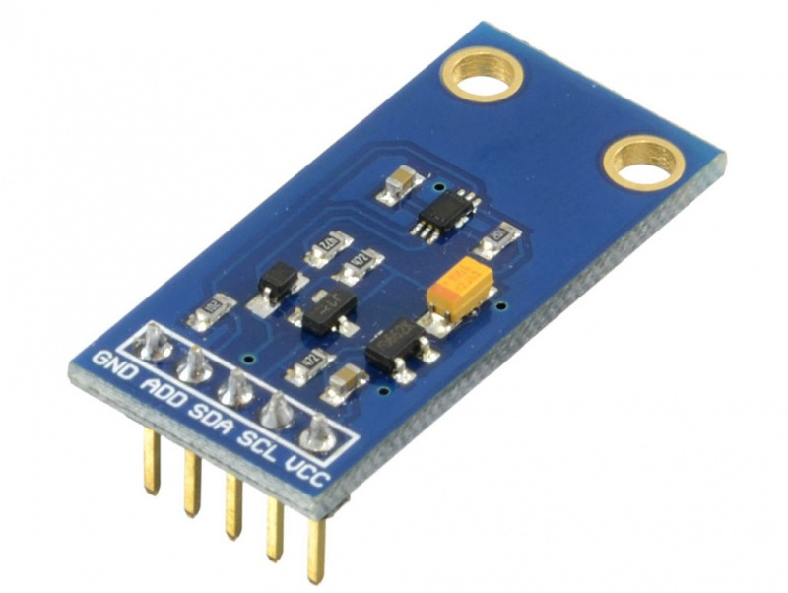
Increment 1 – In progress
Load indexes of sensors (Sangpt)

Slide 15
Increment 1 – In progress
Design Webserver – MVC (Phaplv)

Slide 16
Plant | PH | Light | Humidity(%) | Temperature(độ C) | Temperature of soil(%)
Bắp (Ngô) | 5.7 – 7.5 | cây sáng ngắn ngày | 45 | 32-35 | 60-70
Họ bầu bí | 5.5 – 6.8
Bông cải xanh | 6.0 – 6.5
Cà chua | 6.0 – 7.0 | cây ưa sáng | 40-60 | 21-24
Cà phê | 6.0 – 6.5 | thích as tán xạ | >70 | 20-22
Cà rốt | 5.5 – 7.0
Cà tím | 6.0 – 7.0
Cải bắp | 6.5 – 7.0
Củ cải | 5.8 – 6.8
Cải thảo | 6.5 – 7.0
Cam quýt | 5.5 -6.0
Cao su | 5.0 – 6.8
Cát tường | 5.5 – 7.5
Cẩm chướng | 6.0 – 6.8
Cẩm tú cầu | 4.5 – 8.0
Đậu đỗ (đỗ tương) | 6.0-7.0
Đậu phộng | 5.3 – 6.6
Dâu tây | 5.5 – 6.8
Đậu tương | 5.5 – 7.0
Đồng tiền | 6.5 – 7.0
Dưa hấu | 5.5 – 6.5 | Cây ưa sáng | 40-60 | 25-30
Xà lách | 6.0 – 7.0
Bông | 5.0 -7.0
Cây chè | 4.5-5.5 |  | 30-50
Hành tây | 6.4-7.9
Cà chua | 6.3-6.7
Trà | 5.0 – 6.0
Cây tiêu | 5.5 – 7.0
Thuốc lá | 5.5 – 6.5
Thanh long | 4.0 – 6.0
Súp lơ | 5.5 – 7.0
Ớt | 6.0 – 7.5
Nho | 6.0 – 7.5 |  | 30-50
Mía | 5.0 – 8.0
Mai vàng | 6.5 – 7.0
Lúa | 5.5 – 6.5 |  |  | 32-37
Lily | 6.0 – 8.0 |  | 20-30
Khoai tây | 5.0 – 6.0 |  | 30-50
Khoai lang | 5.5 – 6.8
Hoa lan | 6.5 – 7.0
Hoa hồng | 5.9 – 7.0 |  | 30-35
Cúc nhật | 6.0 – 8.0
Hành tỏi | 6.0 – 7.0
Gừng | 6.0 – 6.5
Dưa leo | 6.0 – 7.0
Rau gia vị | 5.5 – 7.0
Khoai mì (sắn) | 6.0 – 7.0
Cây bơ | 5.0 – 6.0
Dưa chuột | 6.5-7.0 | 10-12h/ngay | 85-95 | 20-30
Chuối | 6.0-6.5

Slide 17
Increment 1 – Delay & Risks
Hardware: late of order MCU and soil moisture sensor.
Lack of face to face working together.
Lack of member share of understand.

